Slide 1

How Much is it Going to Cost?

Slide 2

Be clear how HE finance works
No up front fees!
Tuition Fees are up to £9,250
75% of universities will be charging this higher fee
What you pay back depends on what you earn and only if you earn more than 21k per annum (£1,750 per month) after graduating (Now fixed until April 2021)

Slide 3
Be clear how HE finance works
You pay back 9% of anything over the £21,000
Income | Repayment per month
£25,000 | £30
£30,000 | £67
£40,000 | £142
The debt is wiped after 30 years
30% of graduates a expected to never repay the full amount

Slide 4

Living Costs
Student accommodation

Slide 5


Living Costs
Student accommodation
£105 per week - £220 per week (uncatered)
£165 per week - £330 per week (catered)
Costs are usually cheaper in a shared house off campus

Slide 6
Living Costs
Food
Books
Clothes
Travel
Socialising!?!

Slide 7
Financial Support
Maintenance loans to meet living cost range between £3928 - £8,430
£3928 is available to everyone and is paid in three termly instalments
The remainder is means tested (Based on parents’ residential income)

Slide 9
Bursaries (Free money!?!)
Bursaries range from £100 to £9,000 for a single academic year
All institutions charging more than the basic tuition fee are obliged to offer National Scholarship Programme (NSP) awards of at least £3,000 to first-year students with a household income of £25,000
A grades at A level becoming an increasingly popular feature of university bursary programme
Universities and colleges invest a total of £442.2 million in financial support (bursaries, scholarships, fee waivers, accommodation discounts etc).

Slide 10

Very good advice by Martin Lewis at:
Money Saving Expert . com

Slide 11
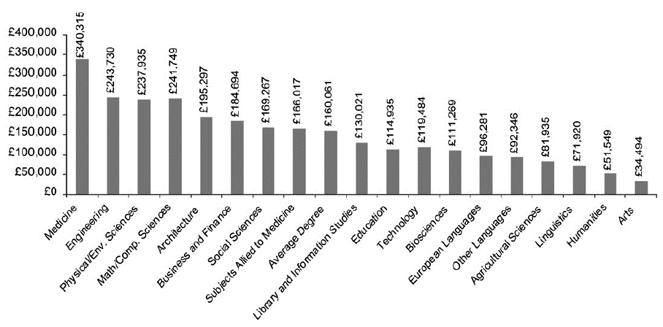
Will Having a Degree Make a Difference to my Future Earnings?
Added lifetime earnings by degree compared to 2 or more A levels

